Slide 1


GOOD MORNING STUDENTS
HOW ARE YOU ?

Slide 2
English For Today, Class: 9+10, Unit: 10
( Contents )
1. Exchange Wish | 7. Group Works
2. Identity | 8. Pair Works
3. Emotion Create | 9. Individual Work
4. Lesson Declaration | 10. Evaluation
5. Lesson Outcomes | 11. Home work
6. Presentation | 12. Goodbye ( The End )

Slide 3
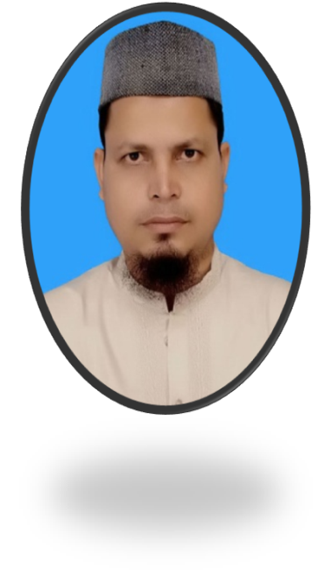
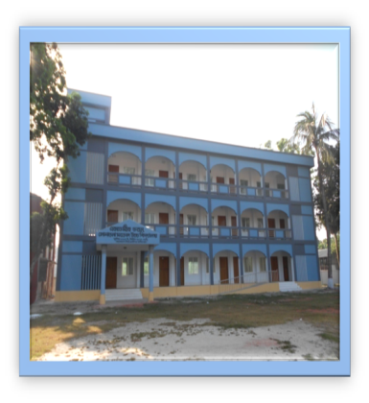
Presented by
SK. MD. HARUNAR RASHID
-B.A.(Hon`s)M.A.B.ED.
Senior Assit: Teacher
Sonatola Model High School
Sonatola, Bogra.
Email: harunarrashidbogra@gmail.com. 01714622498

Slide 4




Pre-knowledge Test (Look at the Picture)
Doctor
Engineer
Judge
Fighter
What is your dream ? And What do you want to be ?

Slide 5
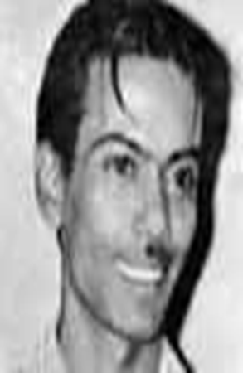







Look at the picture, Do you know him?
Zahir Raihan
Zahir Raihan was a writer, language movement fighter, freedom fighter and film maker. He dreamt a society that will ensure freedom of speech and will.

Slide 6

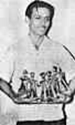
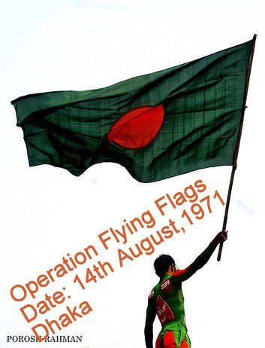
Lesson Declaration
They had Dreams – Part: 2

Slide 7
Learning Outcomes
After we have studied the unit, we will able to
@ listen for specific information.
@ participate in conversations and discussions.
@ write and narrate problems.
@ take and give interviews.
@ determine to do good for our country.

Slide 8

Model reading by the teacher
Zahir Raihan was one of the most talented film makers in Bangladesh. He was born on 19 August 1935 in the village Majupur, in Feni district. He was and active worker of the Language Movement……………………… He could not see the inception of a free independent Bangladesh though he did not get back his brother. And it`s a pity that this dreamer was missing at such a time when his dream came true.
Students will follow the teacher with text book.

Slide 9
Discussion Vocabulary with Meaning
Main word | Synonym | Antonym
Active | Busy | Inactive, lazy
Result | Outcome | Cause
Arrest | Catch, seize | Release
Movement | Driving, trend | Stop
Join | Connect, link | Disjoin, unfasten
Democratic | Democracy | Autocratic
Freedom | Liberty | Slavery
Industry | Diligence | Idleness
Legendary | Mythical | Fact
Trust | Believe | Disbelieve
Help | Support | oppose

Slide 10
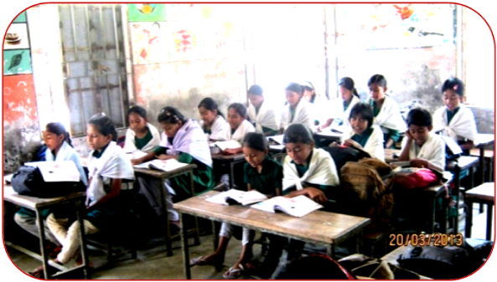
Scilent Reading by the students
Teacher will monitor and help the learners

Slide 11
Practice in groups
Use appropriate information from the text and complete the grid.
Zahir Raihan
Participated in | Famous as | Best documentary | Movie based on language movement | Missing since | his dream
The Liberation War, Language Movement
Film maker
Stop Gemocide
Jibon Theky Neya
30 December 1731
A democratic Society

Slide 12
Practice in pairs
Group - A
Group - B
Why is Zahir Raihan considered a freedom fighter, though he was a film maker ?
How does the title of the lesson fit to the story of Zahir Raihan ?

Slide 13
Individual Works
Read the text again and complete the sentences:
1. Zahir Raihan is famous as………………..
2. Zahir was imprisoned because ………………………………
3. He participated in ……………………… and ………………
4. Jibon theke Neya symbolizes ……………………………….
5. He donated all his money ……………………………………
Film maker.
he participated in the procession on 21 February,`52.
the language movement
the liberation war.
The language movement of 1952.
to the freedom fighter`s trust.

Slide 14

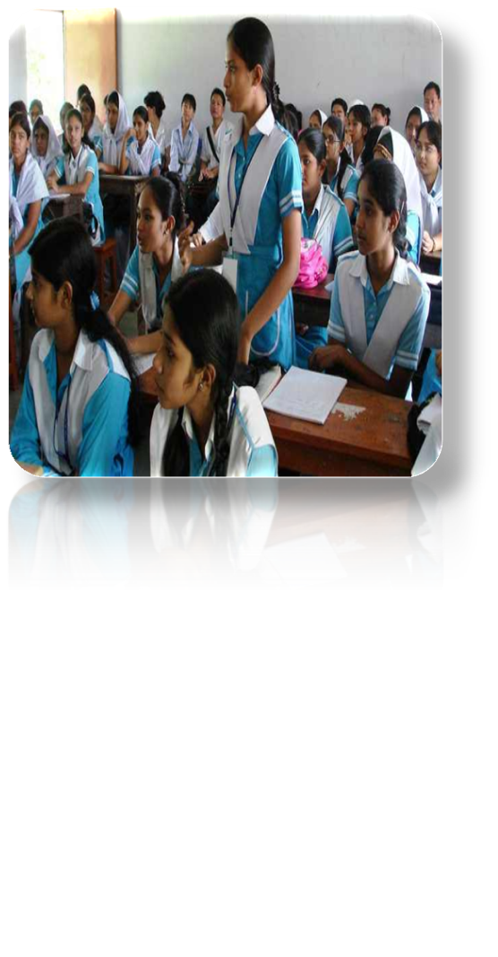
Evaluation (Orally and write on white board)
# What did Zahir Raihan dream all through his life ?
# What was the role of his documentary `Stop Genocide ?
# What was the fate of Shahidullah Kaiser ?
Answer of the above questions:
# Zahir Raihan dreamt for a democratic society that will ensure freedom of speech and will, all through his life.
# The documentary `Stop Genocide’ played a great role in creating world sentiment in favour of our liberation war.
# Shahidullah Kaiser was captured and killed by the Pakisthani army

Slide 15
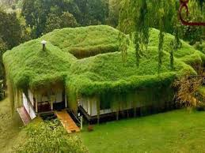
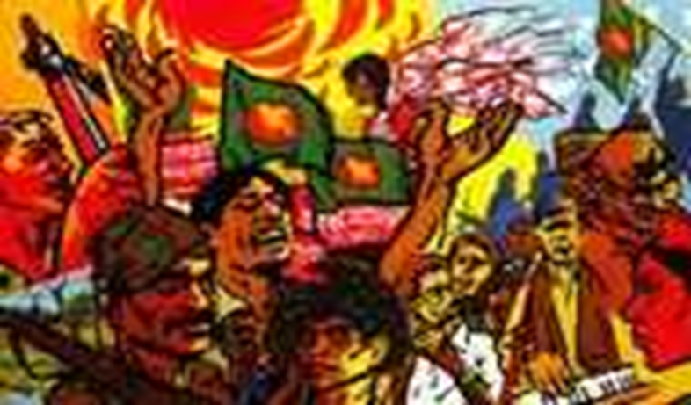
HOME WORK
Meet a freedom fighter in your locality. Interview him/her, then write a paragraph on him/her.

Slide 16


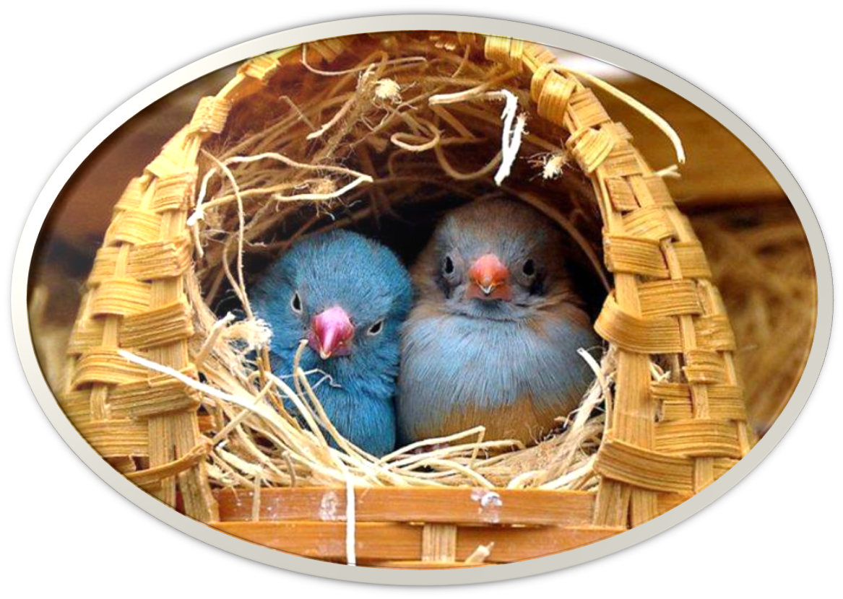
GOOD BYE STUDENTS

